Slide 1
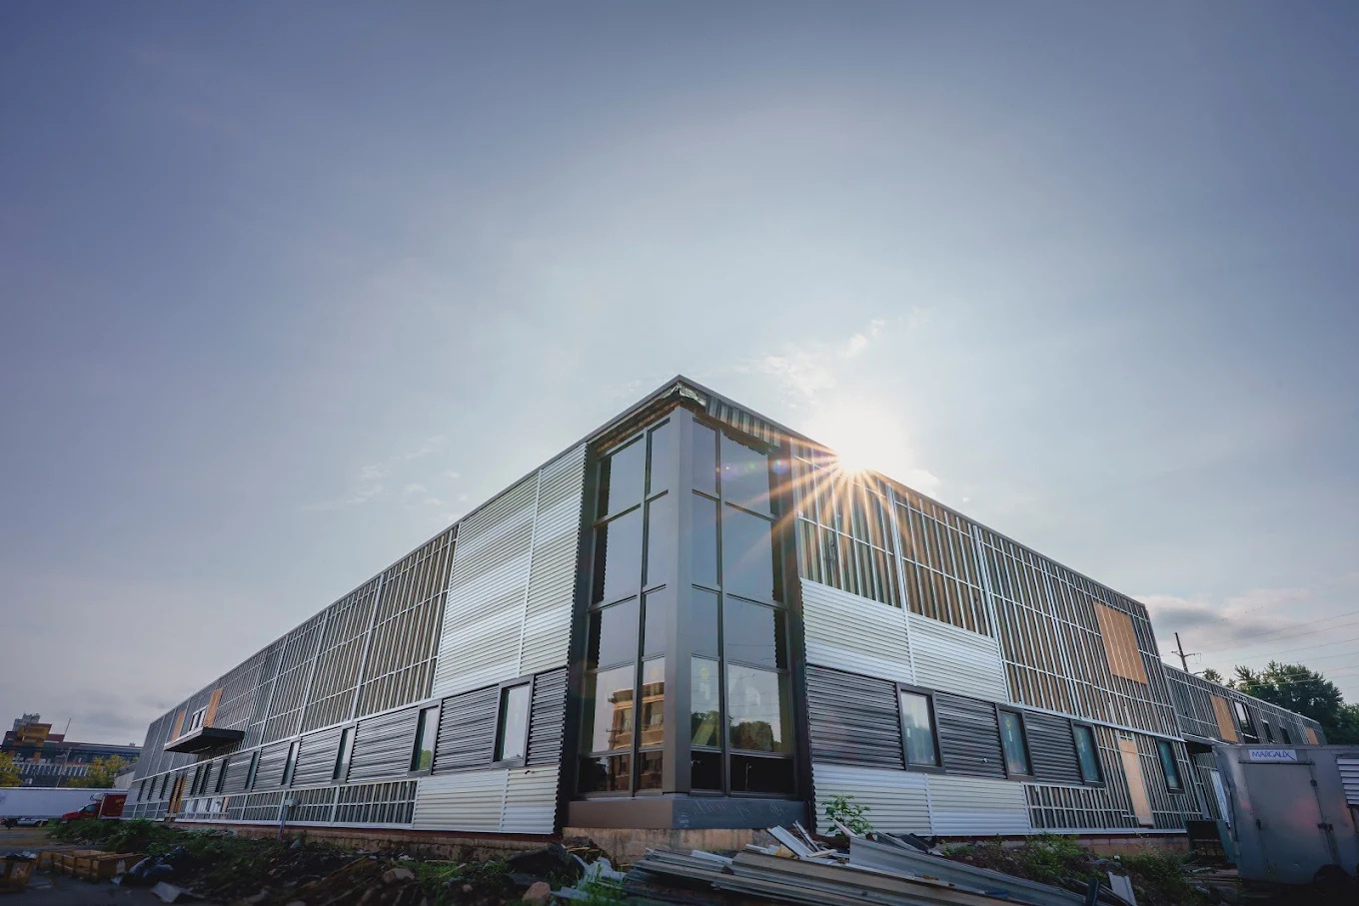



COMMUNITY ROTATION SITE

Slide 2


ABOUT THE WRIGHT CENTER
The Wright Center was founded in 1976. Pioneering physician Dr. Robert E. Wright, led the startup and rallied community support. Dr. Wright and other early proponents of the physician training program were especially interested in developing doctors who would choose to practice locally.

Slide 3
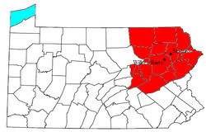
Mission
To improve the health and welfare of the communities through responsive, whole-person health services for all and the sustainable renewal of an inspired, competent workforce that is privileged to serve.
In support of the mission, The Wright Center:
  Co-creates transformational health care teams of leaders who empower people, families, and communities to own and optimize their health.
  Develops and operates a network of primary care community health centers throughout Northeast Pennsylvania that includes primary and preventive care, behavioral health, dental, and addiction and recovery services.
  Trains health care professionals to provide whole-person primary health services and specialty care in a Patient-Centered Medical Home Model approach.
  Promotes the meaningful use of health information technology to enhance the quality and efficiency of care, increase coordination with other providers, and provide patients with access to their health records – all while maintaining the highest levels of privacy and security of personal health information.
  Offers needs-responsive, community-based health promotion and outreach programs.

Slide 4



VISSION
For our Graduate Medical Education Safety-Net Consortium framework that integrates patient care delivery, workforce development, innovation, and empowered voice of communities to be the leading model of primary health care in America

Slide 5
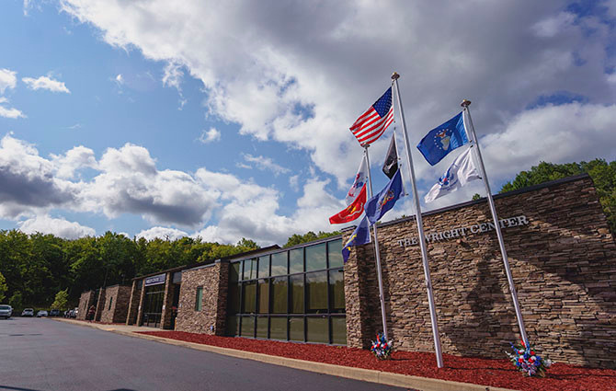





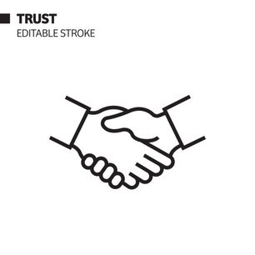

VALUES
Be driven for excellent results
Do the Wright thing
Be trustworthy and accountable
  Spread optimism
Be privileged to serve
Be an exceptional team member

Slide 6

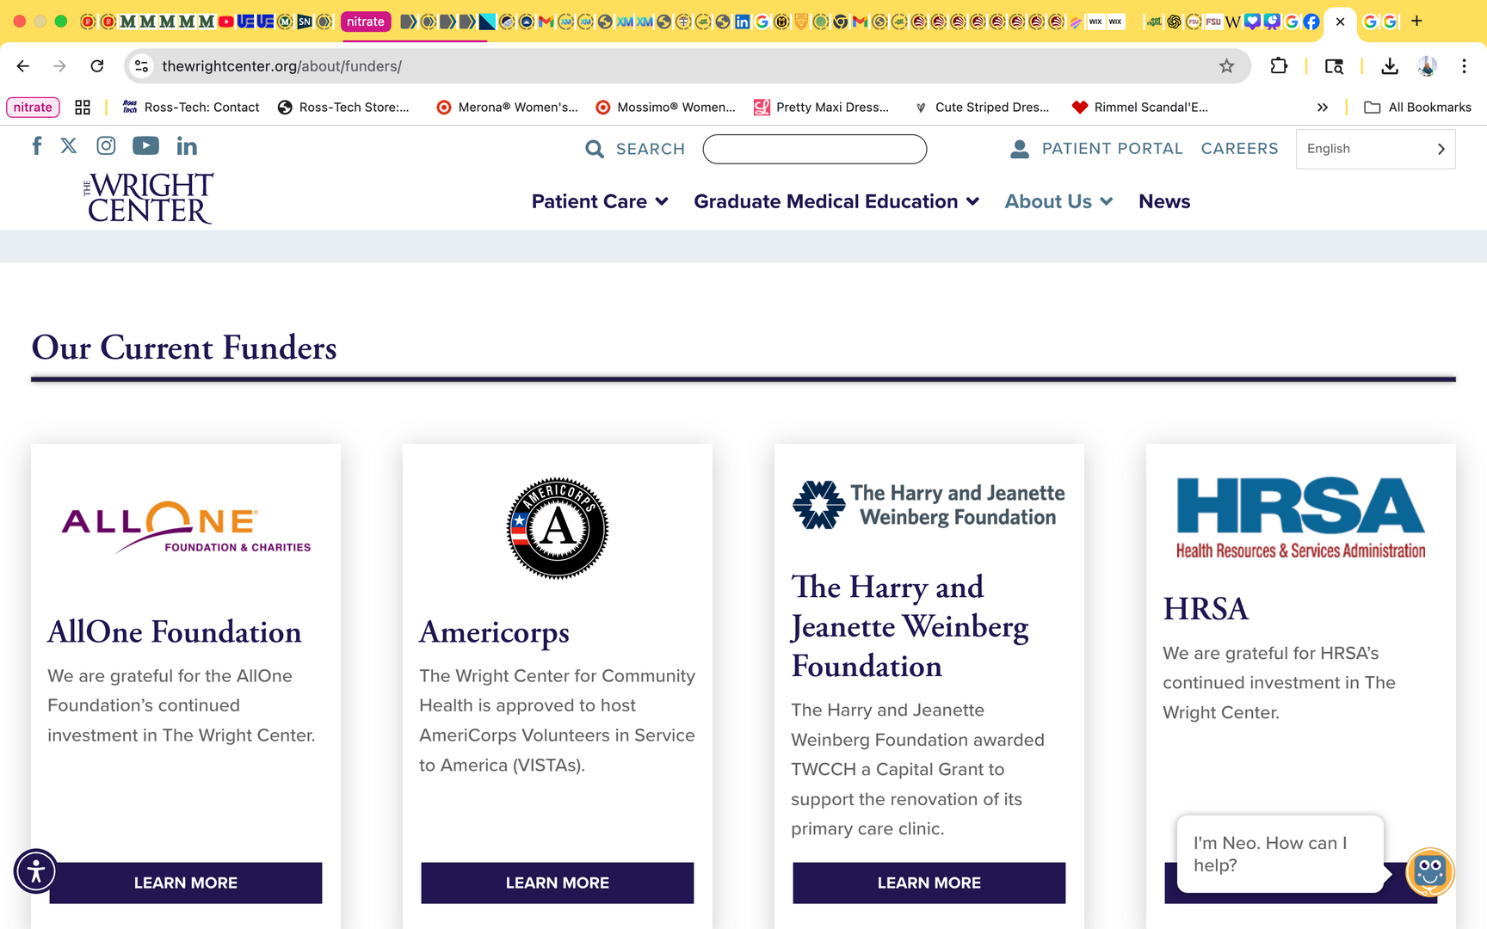
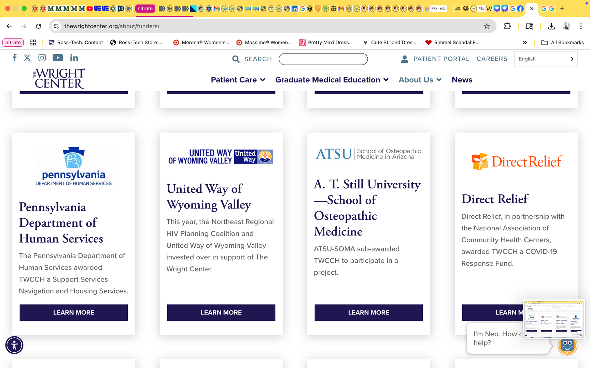
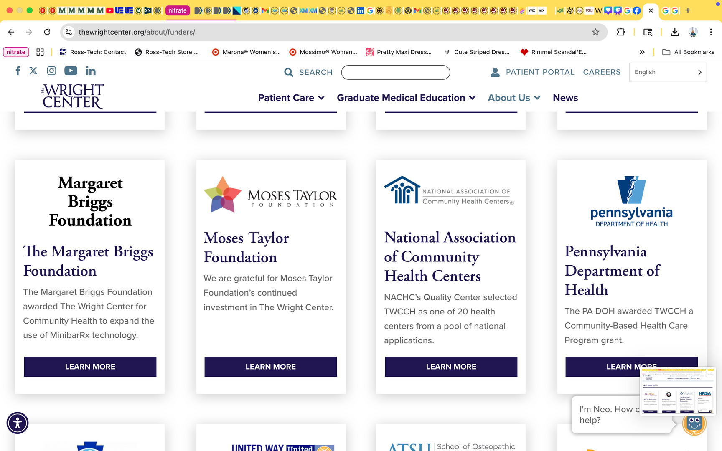
FUNDING
Along with the exceptional leadership from the board members and active engagement of collaborative partners and staff, they have local and national funders who believe in the mission and financially support the Wright Center's efforts. Through active partnerships with a wide variety of regional and national funders,

Slide 7
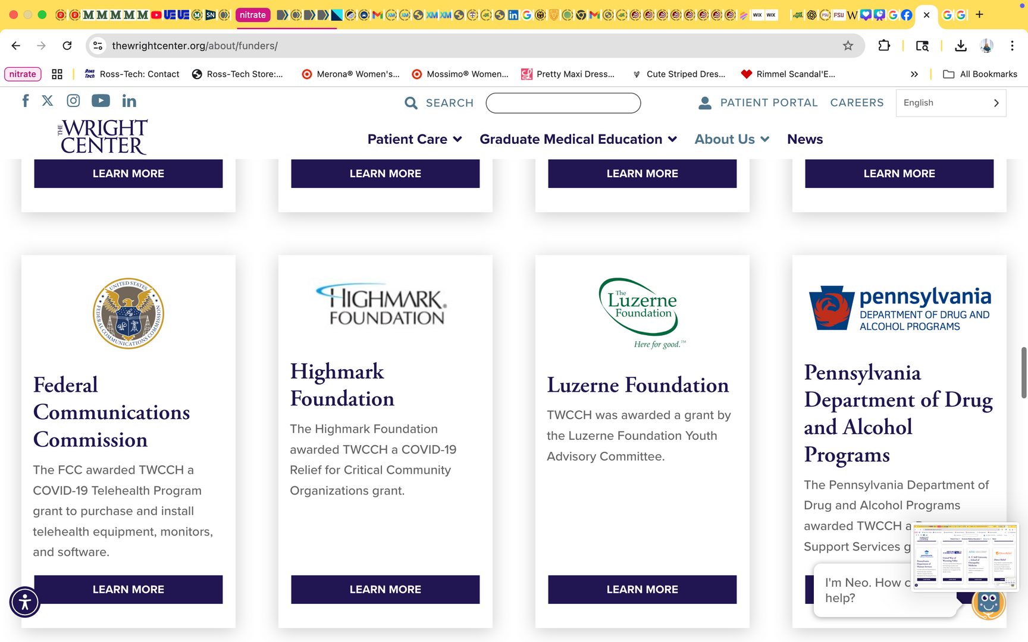
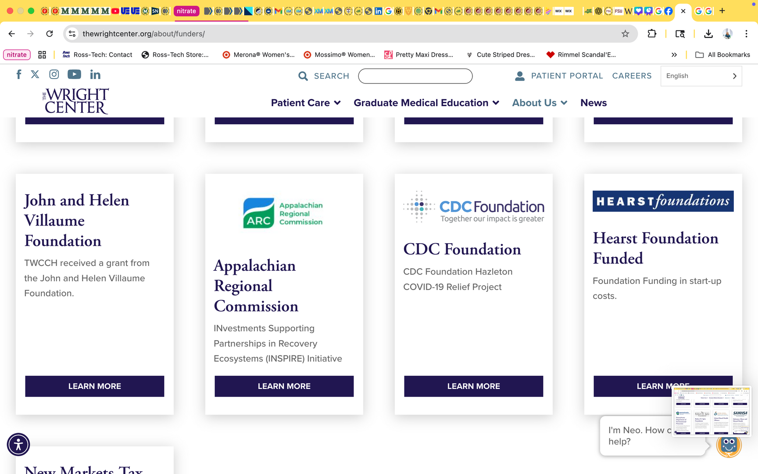
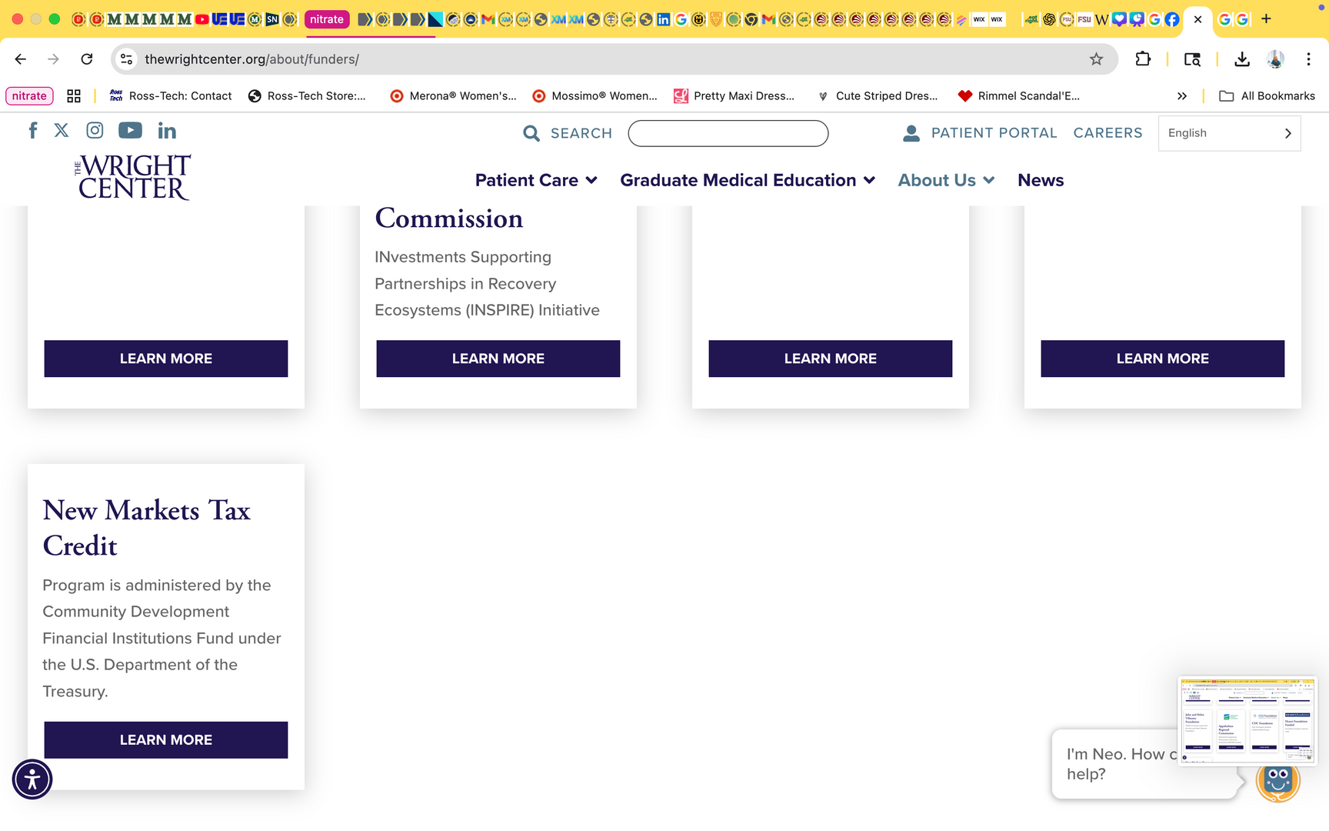
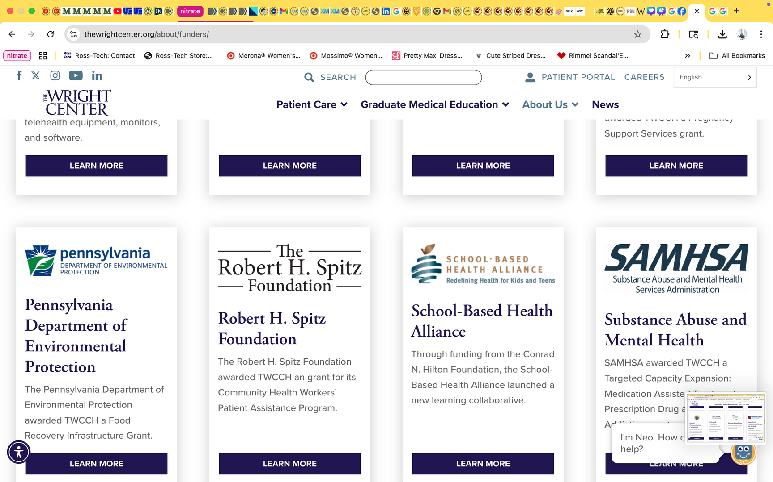
FUNDING

Slide 8
CLIENTS AND ELIGIBILITY,
The Wright Center for Community Health provides services to everyone, regardless of their income level or insurance status. They are committed to providing affordable, high-quality healthcare to all patients, including those who are uninsured or have Medicaid.

Slide 9
HEALTH PROMOTION PROGRAM
My program includes an educational session and a manual (Healthy Eating Manual for Busy Workers in the Health Sector)
This project aims to educate all workers at The Wright Center, tips and tricks on how to eat healthy and prepare meals for work: it describes what a healthy meal includes, food servings from each group, budget budget-friendly grocery list, helpful tools to include in your kitchen, meal preparation tips, and healthy, easy recipes.
  Lectures
  Manual
  procures

Slide 10



THANK YOU
Reem Dasa

